Slide 1
Plant Disease Classification

Slide 2
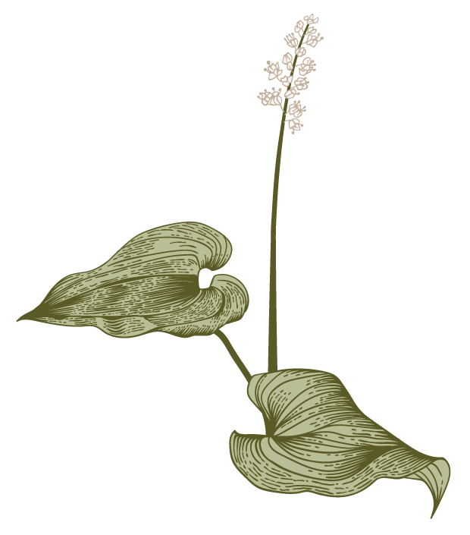

Outline
0
Abstract
Introduction
Motivation
Objectives and scope
System requirement
Training and Testing Algorithm
Applications
Summary

Slide 3
Abstract
In the project, we used machine learning models for utilizing to detect plant diseases in the agriculture sector. Automatic plant disease detection, which recognizes indications of the illness as soon as they occur on plant leaves, is crucial in agricultural research for monitoring huge fields of crops. With some training samples from those two groups, the automatic classifier CNN will be employed for this method of categorization. Last but not least, the error during the outcome demonstrates that the employed network classifier offers less error during training and greater classification accuracy. Farmers engage with agricultural consultants to identify plant diseases.

Slide 4
Introduction
Automatic detection of diseases by just seeing the symptoms on the plant leaves makes it easier also machine vision to provide image-based automatic process control.
Image segmentation is grouping an image into different parts. This Thresholding process is an advanced color method This process is based on various features found in the image.
Genetic algorithm searches from a large sampling of the cost surface. A large number of variables can be processed and Gives a number of optimum solutions, different image segmentation results can be obtained.

Slide 5
Motivation
Farmers find it challenging to recognize a variety of plant illnesses.
Worldwide crop losses resulting from plant disease are estimated to be $60 billion annually.
Since it requires a lot of manual labor and time, typical tools and techniques are not very useful.
The obstacles will no longer be a barrier, though, with the aid of a disease-detecting system.

Slide 6
Objectives And Scope
Objectives:
To identify the relationships between the disease-causing organisms and their host plants in relation to the ecosystem as a whole.
To put into practice a technique for illness prevention and offering management for lowering the losses/damages brought on by diseases.
to recognize numerous plant diseases.
Scope:
Avert plant diseases for farmers.
Assist the pesticide manufacturer in foreseeing new pesticide remedies

Slide 7
System requirement
Hardware Requirements
Processor: Intel Core i3
RAM: 4 GB
Hard Disk: Minimum 500 GB
Software Requirements
Operating System: Windows 8 onwards
Programming Language: Python 3.8.
Browser: Google Chrome Hardware

Slide 8
Training and Testing Algorithm
Steps
1. Collecting Data
2. Preparing the Data
3. Choosing a Model
4. Training the Model.
5. Evaluating the Model
6. Parameter Tuning
7. Making Predictions.
8. Deployment

Slide 9
Applications
Image Recognition:-. Image rearrangement in a machine-learning environment Software's capacity to recognize things, locations, people, text, and actions in images is known as machine vision.
Classification: It offers a precision of roughly 93% for the accurate and automatic diagnosis of leaf diseases.
Prediction:- The camera and app that make expert forecasts.
Extraction:- Techniques for extracting medicinal herbs The separation of the plant's medicinally effective parts is referred to as extraction.
Prediction of plant diseases and advice on fertilization

Slide 10
Summary
Describe a deep convolutional neural network model to identify plant foliar diseases.
80,000+ photos were used for training and validation.
shown that the model can be used to predict a wide range of plant disease types..
The suggested method might be adopted in the future by including more services like neighboring public stores and a pesticide price list. open market nearby, among other things.
Also, the suggested system might be accessible via an application.
The given system uses resizing, thresholding, and Gaussian filtering for image preprocessing. To segment the leaf area' Then finally CNN classification technique is used to detect the type of plant disease.

Slide 11
Thank you
By -
Sai Chandu Sunkara
Farhad Ahamed Biswas
Abdul Azad
Ankit Kumar Singh
Ambika Nayak

